Slide 1
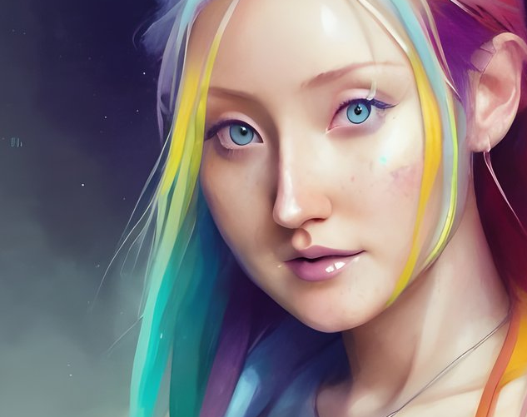
Virtual Friend Chat Bot
NEF 3002 Applied Project II
Semester 2 , Block 2, 2022
Group 8
Author:
Salon Thapa(s4662694)
Robinson Karki(s4670336)
Supervised By:
Dr. Sardar Farhad

Slide 2

Introduction
The aim of this project was to create personalised virtual friend website using GPT-3 NLP based model.
In this website, user can interact chatbot which act as virtual friend and get emotional support based on their data provided using GPT-3.5 Turbo.
Our project is not just only getting responses from GPT-3.5 Turbo; it’s about training your own data to GPT 3.5 turbo to act as friend.

Slide 3
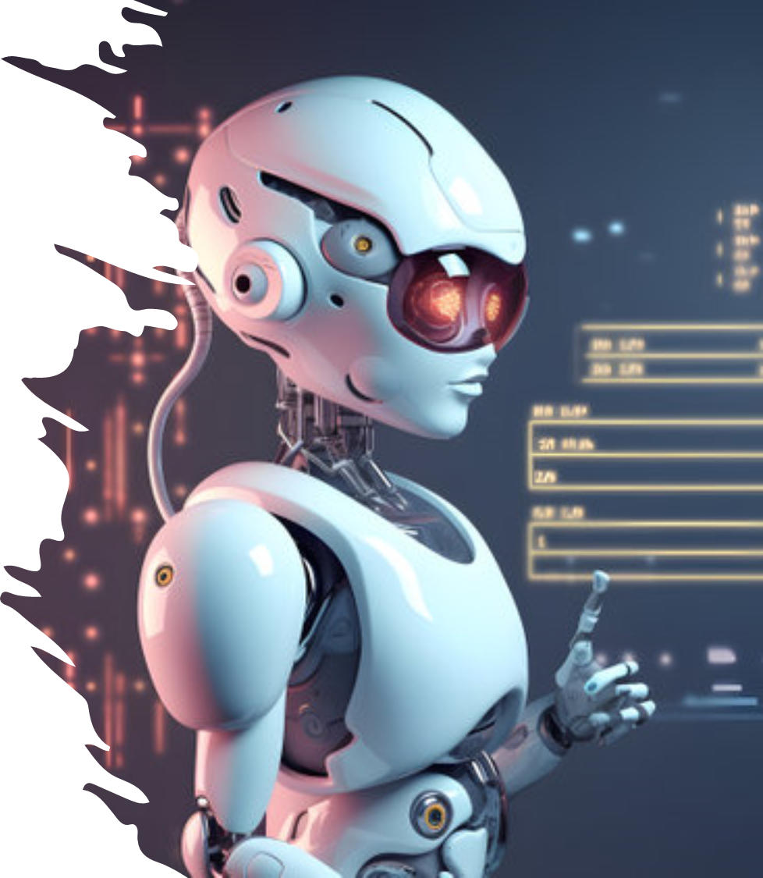
Agenda
Introduction
Milestone
User-Centered Design
System Architecture
Use Case Diagram
Development Tools
Conclusion
References
Objectives
Literature review
Challenges and Solutions
User Interface
Customization Capabilities
Future Enhancements
Q&A

Slide 4
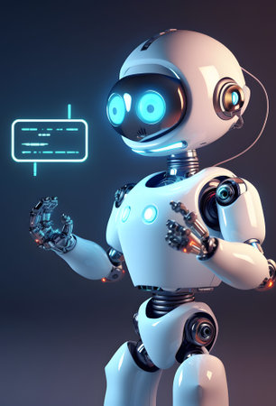
Objectives
Purpose
Overall objective of our project is to create a virtual friend that could foster meaningful conversations with users by providing personalized responses based on their input.
Human like Conversation
Our virtual friend engages users in personal, human conversations, promoting companionship and entertainment.
Magic of NLP
User can discover the magic of Natural Language Processing (NLP) with GPT-3, enabling contextual and coherent answers on a variety of topics.
Improve well-being
Our project aims to improve users' well-being, promote connectivity and provide emotional and spiritual support.

Slide 5

Literature review
In the 1990s and early 2000s, chatbots such as ALICE and Jabberwacky gained popularity and offered opportunities for AI-based conversation.
NLP forms the backbone of virtual chatbots, enabling them to understand and generate human responses to text.
Research has classified virtual chatbots into different types, including information bots (which deliver facts and information), event bots (which perform functions such as booking appointments), and virtual assistants (which provide various services and interactions).

Slide 6

Milestone
Conceptualization and launch of a project.
Choice of technology and installation of tools
Overcoming initial challenges with Python and transitioning to Java and PHP
Chatbot UI and backend development
Addressing API integration challenges
Successful completion of chat with data search capabilities
The project schedule was strictly observed, and it was ensured that every milestone was achieved within the specified time frame.

Slide 7

User- Centered Design
Include an easy-to-access feedback system in the chatbot user’s interface
Offer customization option to add trained data from the user.
Give the chatbot the ability to react sympathetically to users who express sadness .
Design a simple and user-friendly chat interface with clear navigation.

Slide 8
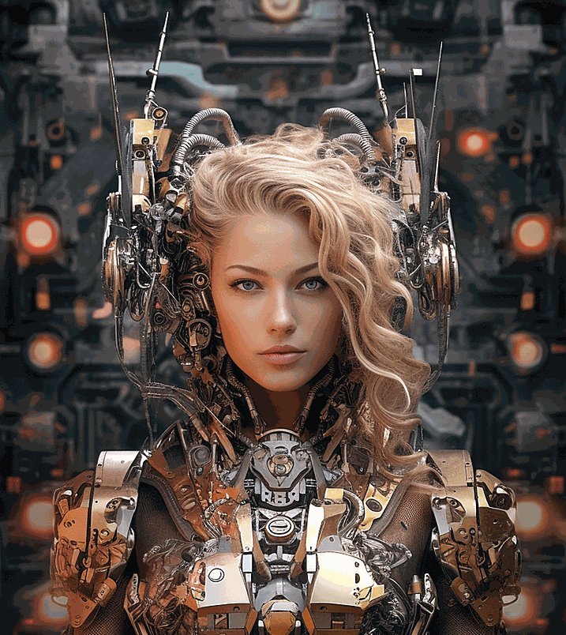
System Architecture
The chatbot user interface acts as the main point of communication between users and the system.
It provides a user-friendly chat interface accessible through web browsers that allows users to initiate conversations and receive responses.
Effective context management ensures that the chat can maintain context during long conversations.
To maintain a high level of user-centricity, we are committed to a culture of continuous improvement and make improvements regularly.

Slide 9
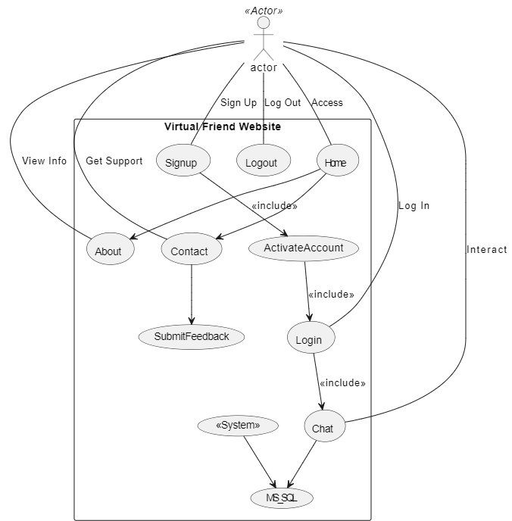
Use Case Diagram
our website provides a user-friendly homepage that allows you to log in and log in to the chat interface. Users can go to the "About" page to get detailed information about the virtual friend and the "Contact Us" page to provide feedback and contact support. Registration sends an activation email where user data is securely stored. After logging in, users interact with a chat room. The chat history is stored in the My SQL database.

Slide 10

Development Tools
Visual Studio: Learn how this versatile integrated development environment (IDE) played a central role in coding and debugging, ensuring smooth development.
Xampp and MySQL: Provides a robust local server environment, simplified database management and enabled the website to run smoothly.
GPT-3.5 API Key: The magic of the OpenAI GPT-3.5 Turbo model and its API key gave our project advanced natural language processing capabilities.
Java and PHP: Helps in back-end development for creating responding website.
HTML and CSS: Helps us to create user friendly and attractive websites.

Slide 11
Challenges and Solutions
Challenges
Solutions
Switching from GPT-3 to GPT-3.5 Turbo
Lack of data training
Ensuring user privacy and ethical use of AI
Deployment complexity
Transition from Python to Java and PHP
Allow user to customize their chatbot data for personal interactions
Apply privacy-focused design principles, encryption, and follow ethical AI guidelines.
Addressing Domain hosting and DNS resolution.
Codebase customization and updated development methods
Revising code for improved performance of GPT-3.5 Turbo.

Slide 12
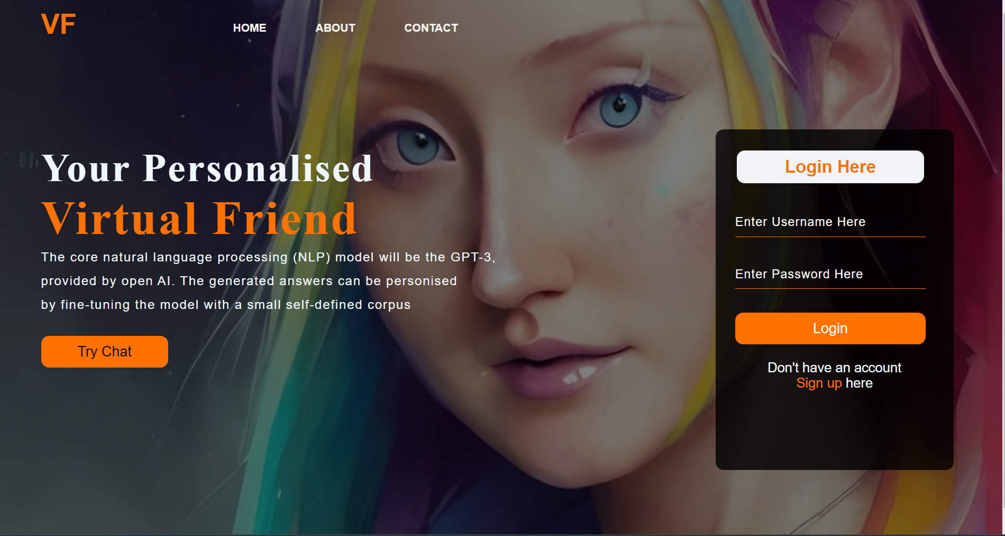
User Interface
Home page

Slide 13
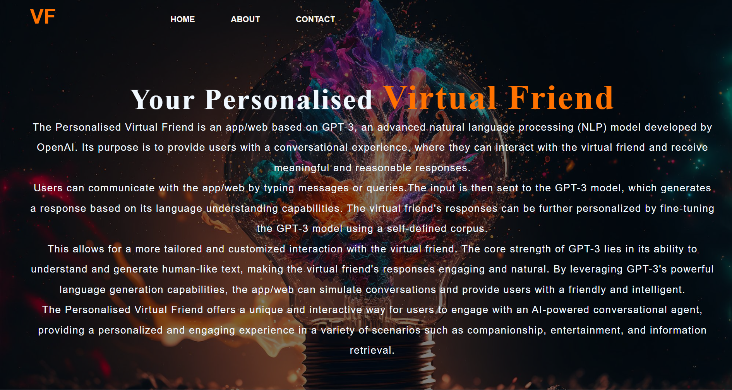
User Interface
About page

Slide 14
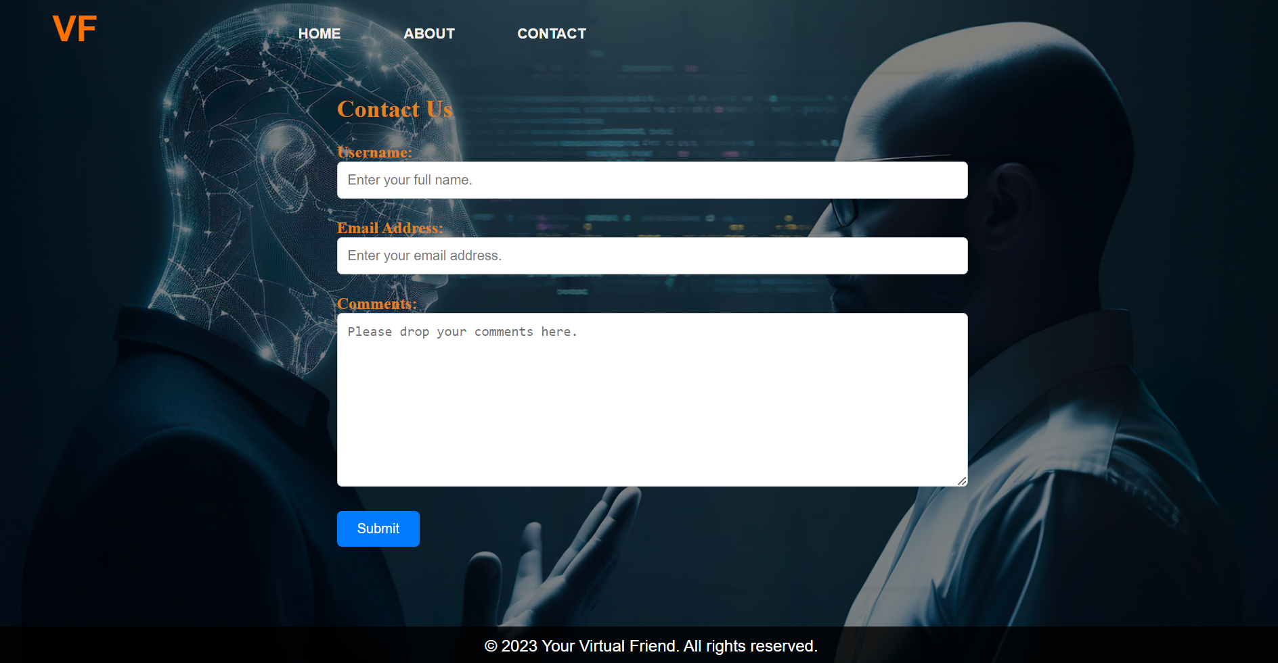
User Interface
Contact page

Slide 15
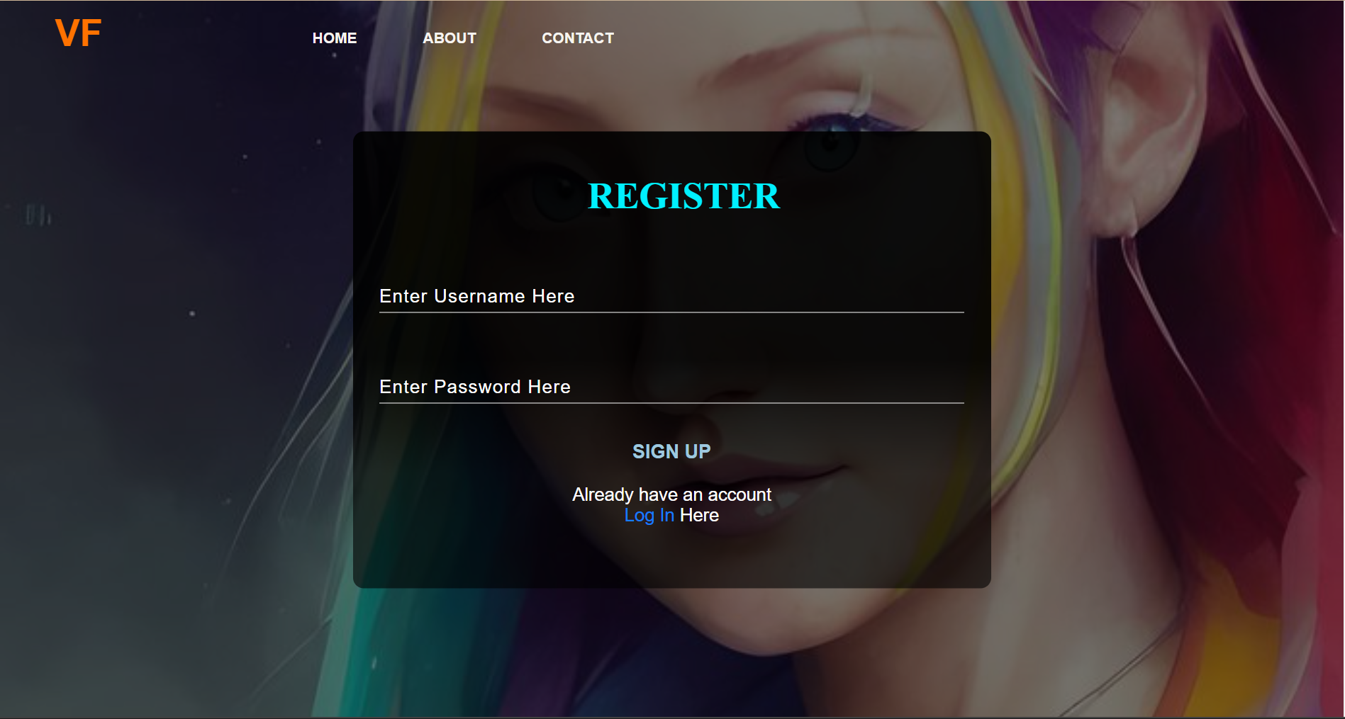
User Interface
Registration page

Slide 16
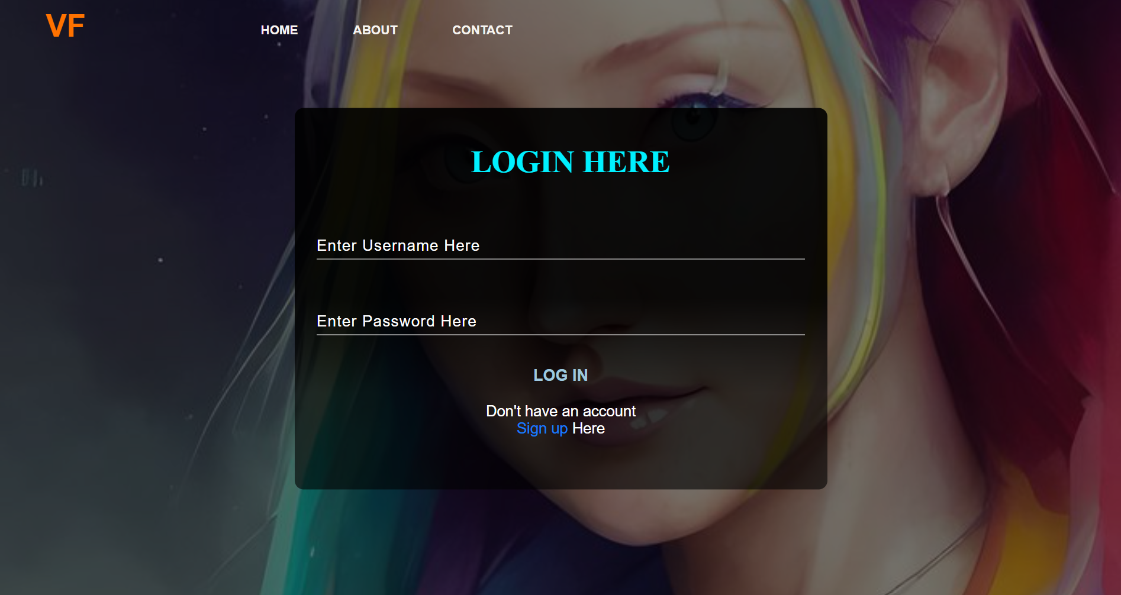
User Interface
Login page

Slide 17
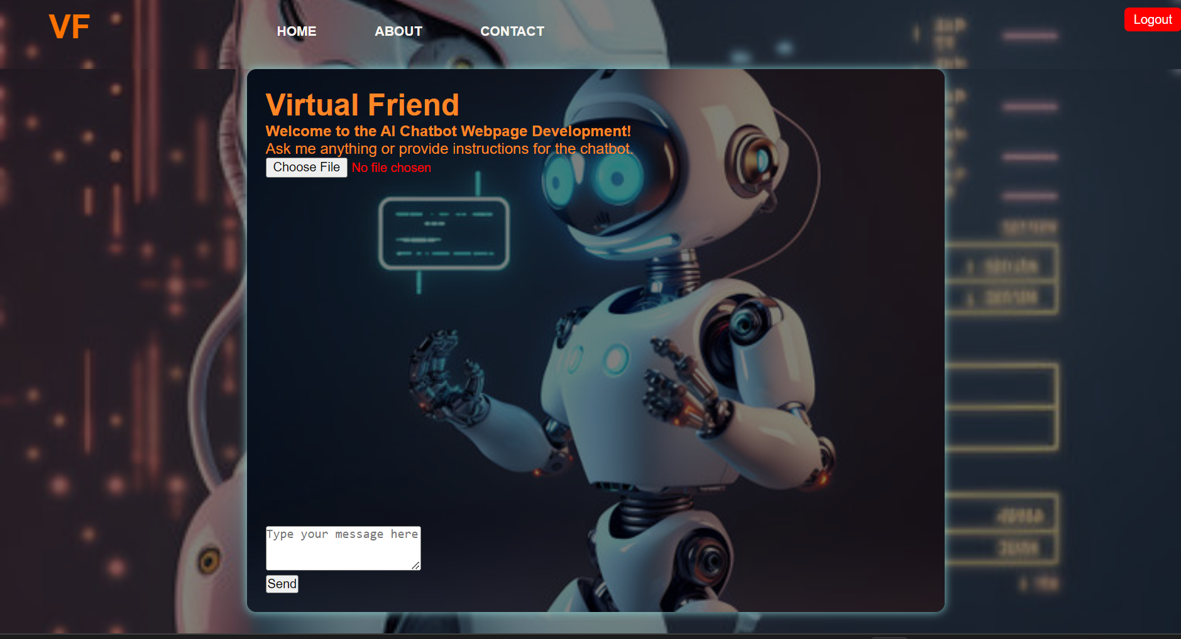
User Interface
Chat page

Slide 18
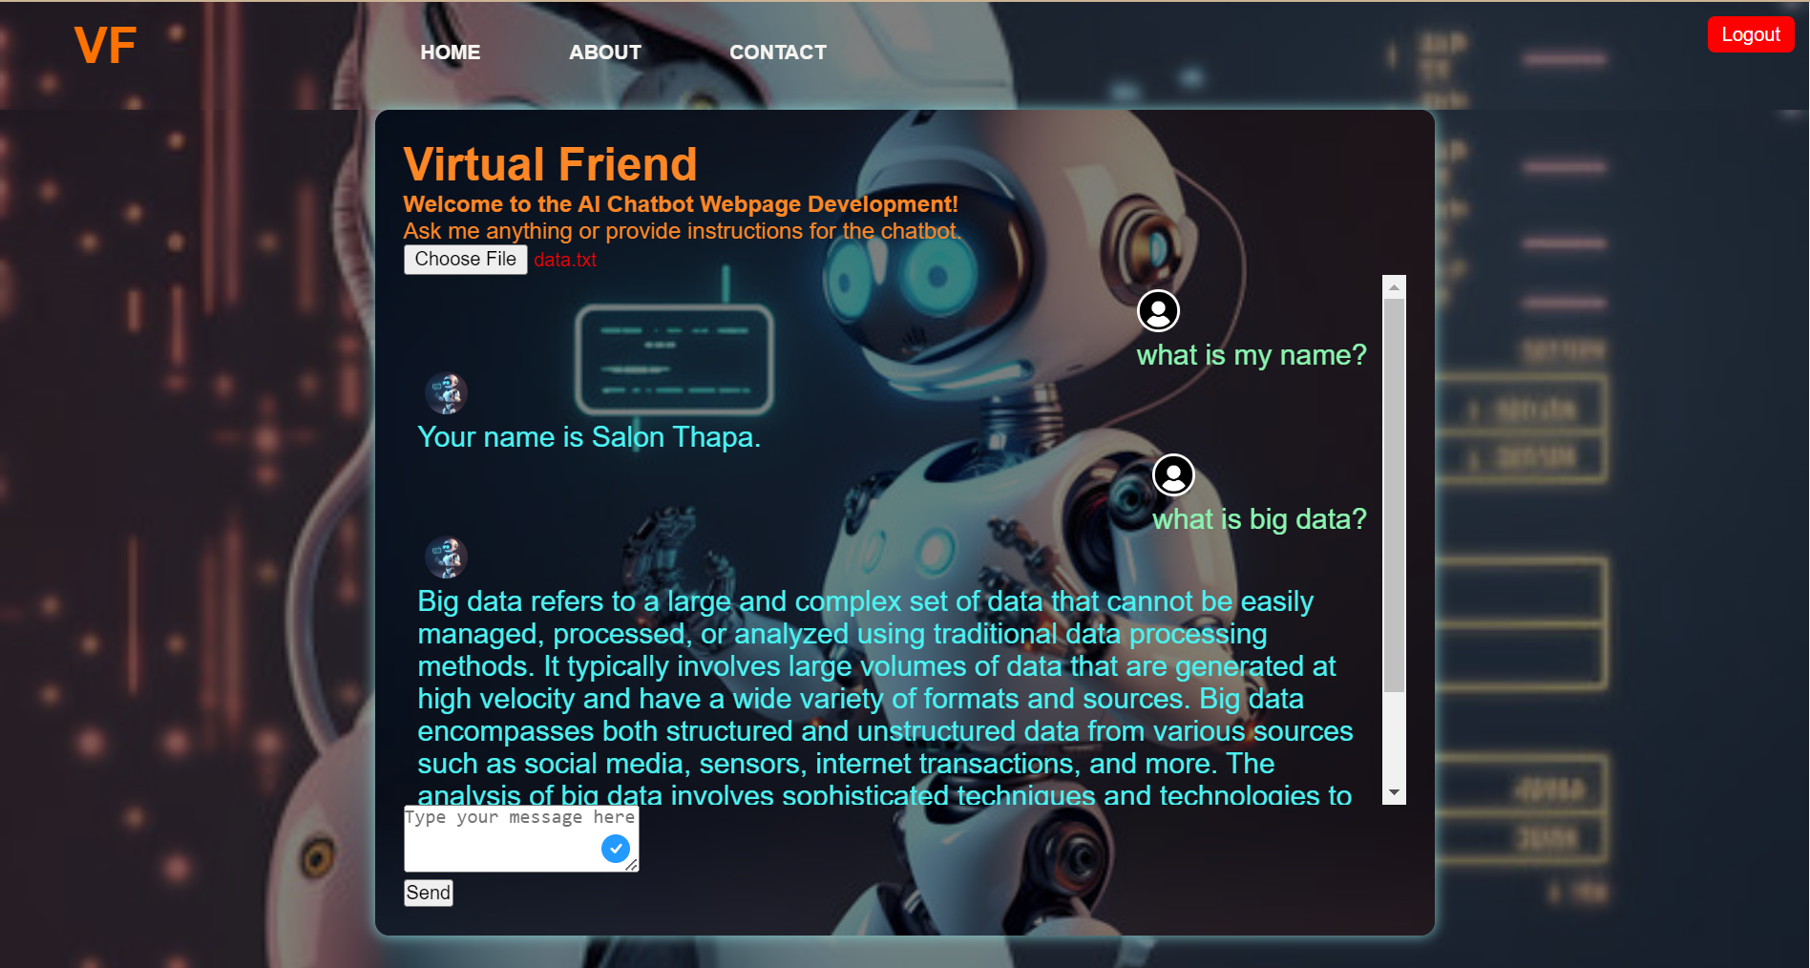
Customization Capabilities
User can provide their own data and get response based on their data provided. If information is not found in user data, then it will provide call GPT 3.5 turbo to generate response.
Example: Suppose if user tell what is your name , it will give my name Salon Thapa. I had provided data with my name. So, it give me response based on my data.

Slide 19

Future Enhancements
We will focus on major on following key point:
Strengthening Privacy
Data Enrichment
Interactive user interface
User-Centric Evolution
Advances in Machine Learning and NLP:

Slide 20

Conclusion
In addition to visible outcomes, our project also provided us with priceless lessons. We began as a plan for a mobile platform has transformed into a sophisticated web platform that offers highly personalized experiences. We made some key findings throughout this transformation, including the adaptability of customizing use case diagrams, the robust transfer to ChatGPT 3.5 Turbo, and the major benefit of the addition of user-specific data training.
This study is significant because it provides the groundwork for future customized AI and NLP applications while also enhancing user wellbeing. It draws attention to how technologies has the power to improve lives and establish deep connections.

Slide 21

References
Floridi, L., et al. (2018). AI4People—An Ethical Framework for a Good AI Society: Opportunities, Risks, Principles, and Recommendations. Minds and Machines, 28(4), 689-707.
Sommerville, I. (2011). Software Engineering. Pearson Education.
Svantesson, D., & Clarke, R. (2010). Privacy and consumer risks in domain name services. Journal of Law, Information & Science, 20(2), 181-206.
OpenAI (2023). ChatGPT. [online] chat.openai.com. Available at: https://chat.openai.com/.
Jay. (2023, March 26). What is a Virtual Friend and How Does It Work? Gig Hustlers. https://gighustlers.com/what-is-a-virtual-friend-how-does-it-work/
DeepLearning.AI. (2023, January 11). Natural Language Processing (NLP) - A Complete Guide. Www.deeplearning.ai. https://www.deeplearning.ai/resources/natural-language-processing/
Jay. (2023, March 26). What is a Virtual Friend and How Does It Work? Gig Hustlers. https://gighustlers.com/what-is-a-virtual-friend-how-does-it-work/

Slide 22

Q&A
Any Question?

